Slide 1
Aircraft Jet Engines and
Propulsion Systems
Dr. John Polley
Dr. K. Bofah
AERO 364 Propulsion
1

Slide 2
Lecture Topics
Introduction to Propulsion
Jet Propulsion and Control (Dr. John Polley)
Integral Momentum Theorem
Aircraft Propulsion Systems
Gas Generators
Aircraft Performance
Rocket Performance
Rocket Nozzles
Production of Thrust with a Propeller

Slide 3
Aircraft Propulsion Systems
Specific Impulse
Range
Efficiency
η_{ch} η_{th} η_{prop}
Propellant -------→burn ------→expand thru nozzle===➔THRUST WORK
(chem energy) (heat,thermal energy) (mechanical, K.E.)
η_{overall =} η_{ch} η_{th} η_{prop}
η_{ch approx = 1}

Slide 4
Specific Impulse
Specific Impulse (Isp):
Isp = Thrust/Fuel weight flow rate (units seconds)
= T/gm_{f}
Specific Fuel Consumption (SFC or TSFC):
SFC = mass flow rate of fuel/ thrust (lbm/hr/lbf or kg/s/N)
= m_{f}/T

Slide 5
Breguet Range Equation
For steady level flight:
T = W/(L/D)
gm_{f} = - dW/dt
dW/dt = -T/I_{sp} = -W/I_{sp}/(L/D)
solving:
Range R = u_{o}I_{sp}(L/D)ln(W_{o}/W)
air speed propulsion aerodynamics structures &materials

Slide 6
Overall efficiency, η_{o}
η_{o} = what you get/what you pay for
= propulsive power/fuel power
= Tu_{o}/m_{f}h
h = heating value of fluid; i.e. the amount of energy liberated upon combustion of one unit of fuel mass
under specified ideal conditions (typically at 1 atm pressure and with liberation of gaseous products) [J/kg]
h= η_{comb} mf = rate of fuel chemical energy release under actual conditions; η_{comb} is close to one in well designed subsonic burners.
h= 4.3x10⁷ J/kg for typical hydrocarbons
= 12x10⁷ for H₂
R = η_{o}(h/g)(L/D)ln(W_{o}/W)

Slide 7
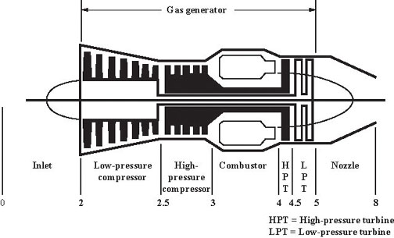
Schematic station numbering

Slide 8
Thermal efficiency, η_{th}
η_{th} = rate of production of kinetic energy/fuel power
= (½mu_{o}² - ½mu_{e}²⁾/m_{f}h)
Ideal Brayton cycle
Qin
Qin = Cp(T4-T3)
Qout = Cp(Te-T0)
ηth = (Qin-Qout)/Qin
= 1 – Te/T4
= 1 – T0/T3
= fn of temp ratio across compressor
p
3
4
0
e
Qout
v

Slide 9
Propulsive efficiency, η_{prop}
Turbojet
η_{prop} = propulsive power/rate of production of propulsive K.E
= Tu_{o}/(½mu_{o}² - ½mu_{e}²)
T = m(u_{e}-u_{o})
η_{prop} = 2/(1 + u_{e}/u_{o})
= 1/[1 + T/(2mu_{o})]
T = ½ρu_{o}²SC_{D}
M = ρu_{o}A_{in}
η_{prop} = 1/[1 + ¼C_{D}(S/A_{in})]

Slide 10
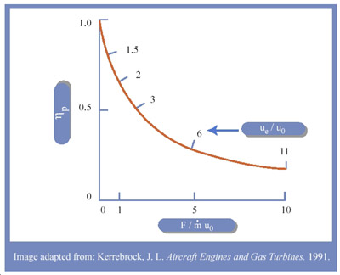
Propulsive efficiency and specific thrust as a function of exhaust velocity

Slide 11
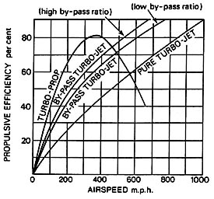
Propulsive efficiency comparison (Rolls Royce)

Slide 12
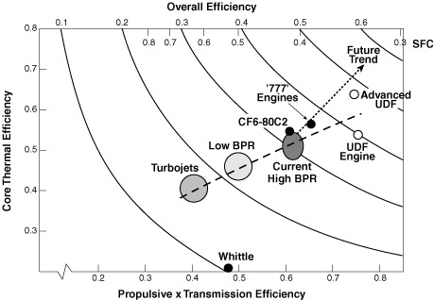
Trends in aircraft engine efficiency (after Pratt & Whitney).

Slide 13
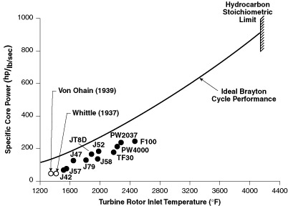
Trends in turbine inlet temperature (Koff, 1991).

Slide 14
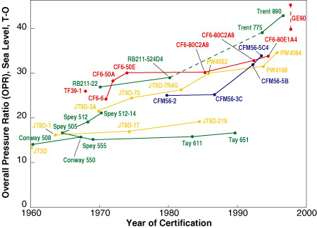
Trends in commercial transport engines (Epstein, 1998).

Slide 15
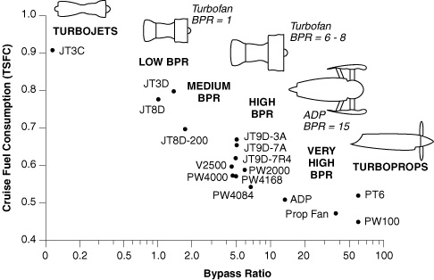
Trends in engine bypass ratio (Epstein, 1998).

